Slide 1
USING AHP AND GOOGLE DORKING FOR MULTI-LEVEL
PLAGIARISM DETECTION IN RESEARCH PAPERS
TEAM DETAILS
Alok Mathur - 20BCE2959
Prasoon Soni - 20BCE2960

Slide 2
Outline
Introduction
Aim & Objective
Problem Statement
Literature Survey
Flow Chart
Performance Measures
Business Model
Proposed Method
Comparison Matrix
Dataset
Result
Conclusion
References

Slide 3


Introduction
Background
Research proposals can take a long time to get approved, and rejection may not always be communicated.
A common cause for delays is the multiple stages a proposal must go through before approval.
The first stage involves submitting the proposal in a specific format and deciding on details such as the problem to be solved or organization to apply to.
The proposal is then checked for plagiarism and finally peer-reviewed and pushed for funding approval/publication.
Each stage of the process is important.

Slide 4
Introduction ctd…
Definition
Research Proposal: A document outlining a proposed research project, typically including details on the research question, methodology, and potential impact.
Plagiarism: The practice of using someone else's work or ideas without giving them proper credit.
Peer review: The process of having a research proposal evaluated by experts in the same field.
NLP: Natural Language Processing, a branch of Artificial Intelligence that deals with the interaction between computers and human language..
AHP: Analytic Hierarchy Process, a decision-making method that helps to evaluate complex problems by breaking them down into smaller, more manageable components.

Slide 5
Introduction ctd…
Applications
Streamlining the research proposal submission process by providing a central platform for researchers to submit their proposals and have them checked for plagiarism.
Reducing the incidence of plagiarism in research proposals by using a custom-built NLP algorithm for plagiarism checks.
Providing researchers with feedback on why their proposals were not approved, allowing them to improve their proposals in the future.
Facilitating the growth of the research field by connecting innovative minds with funding resources.
Providing an extra layer of security by encrypting the data via bcryptjs and storing it in the Ethereum blockchain.
Creating an environment of responsible and competitive research in the country by helping researchers to submit their proposals in a selected format and ensuring that they are not plagiarized.

Slide 6
Aim & Objective
The aim of the proposed system is to address the problem of duplicity of research proposals submitted to various funding agencies, which leads to wasted time and resources for researchers.

Slide 7
Problem Statement
The problem addressed by the proposed system is the duplicity of research proposals submitted to various funding agencies, which leads to wasted time and resources for researchers. The typical research proposal can take weeks to months to even years to get approved, and one may not even get to know that their proposal is rejected and hold onto an empty hope.
A very common cause for this is the fact that a proposal has to go through numerous stages before getting approved. One of the main stages is submitting the proposal in a selected format and deciding all the relevant details like selecting a specific problem to solve or deciding which funding organization to specifically apply to.

Slide 8
Problem Statement ctd…
However, paraphrasing and a lot of other malpractices can go unnoticed when it comes to just plagiarism checks on a basic level. This leads to proposals which get stuck in this stage and not get approved. The main drawback is that the researcher doesn’t get any report as to what caused their proposal to not be approved. Consequently, this results in higher time and resource consumption with no fruitful results. Due to this, at times, a deserving candidate might not get funding, thus slowing down the growth of the research field.

Slide 9
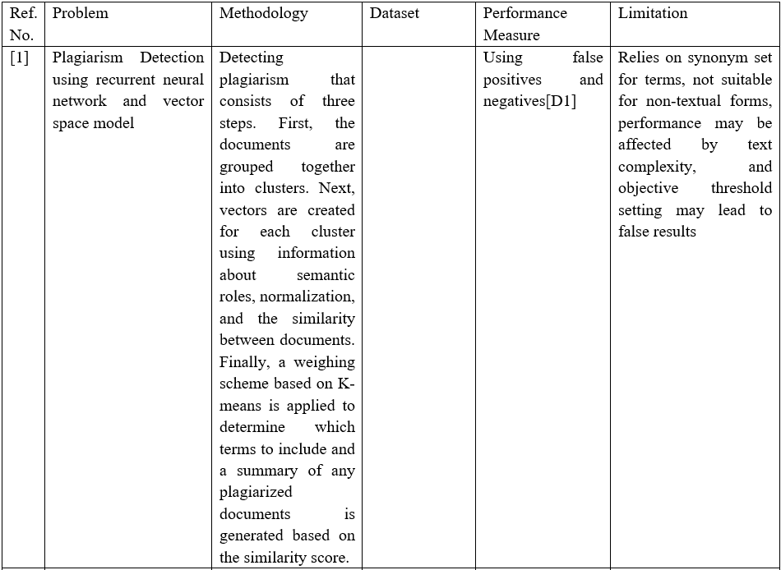
Literature Survey

Slide 10
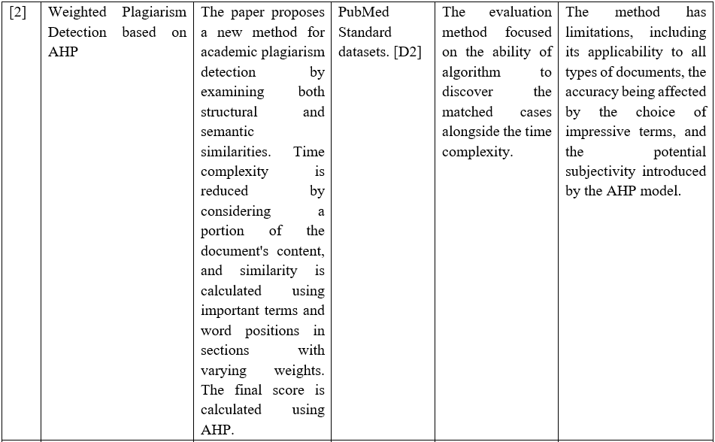

Slide 11
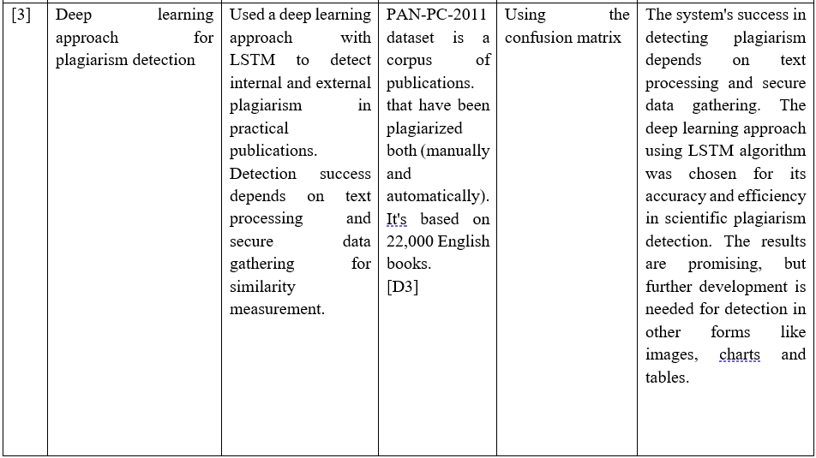

Slide 12
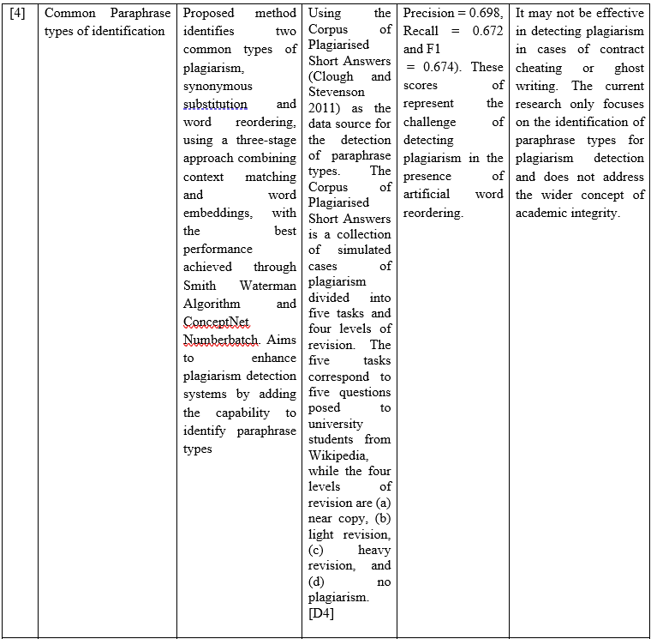

Slide 13
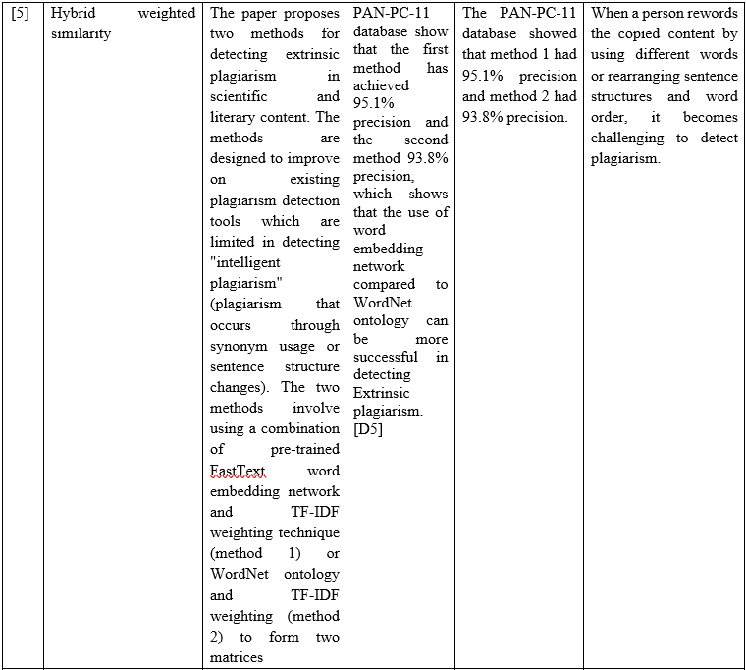

Slide 14
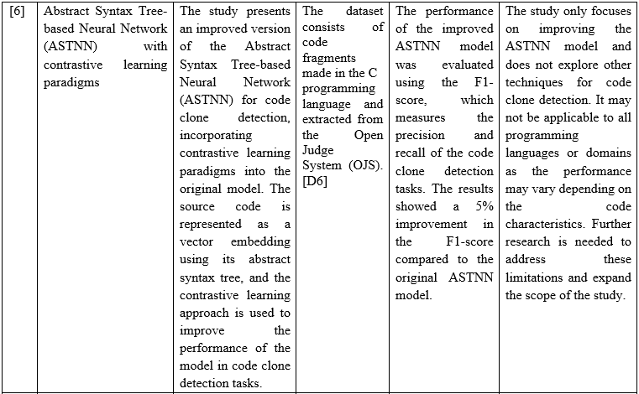

Slide 15
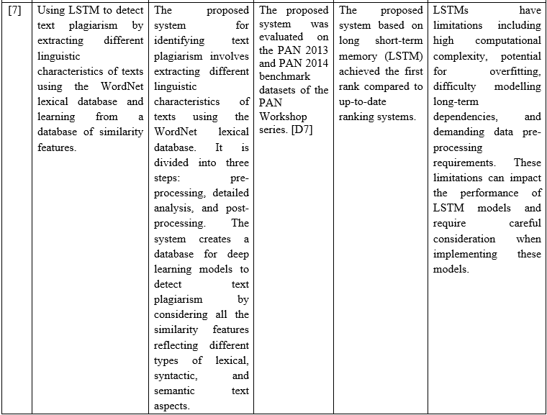

Slide 16
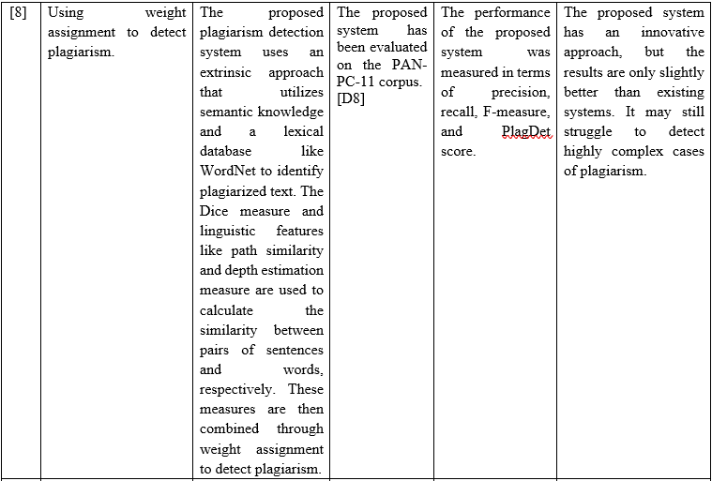

Slide 17
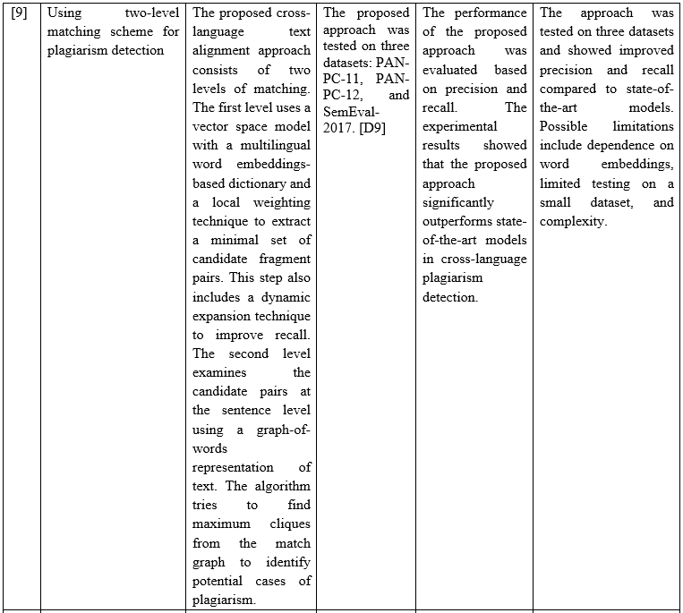

Slide 18
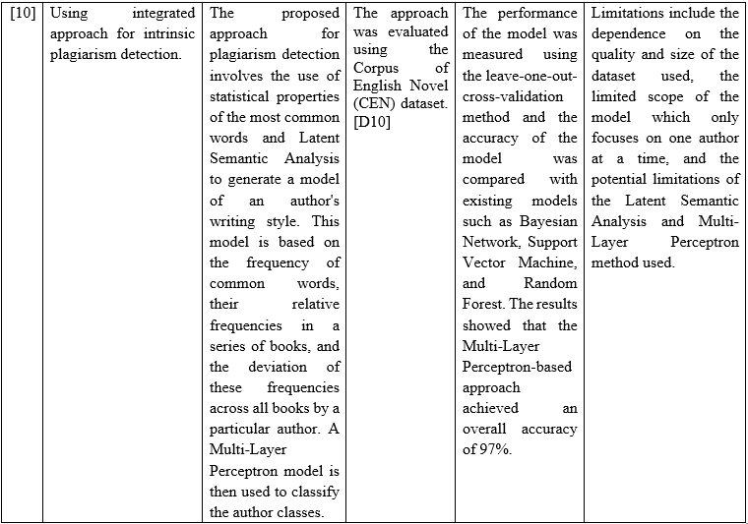

Slide 19
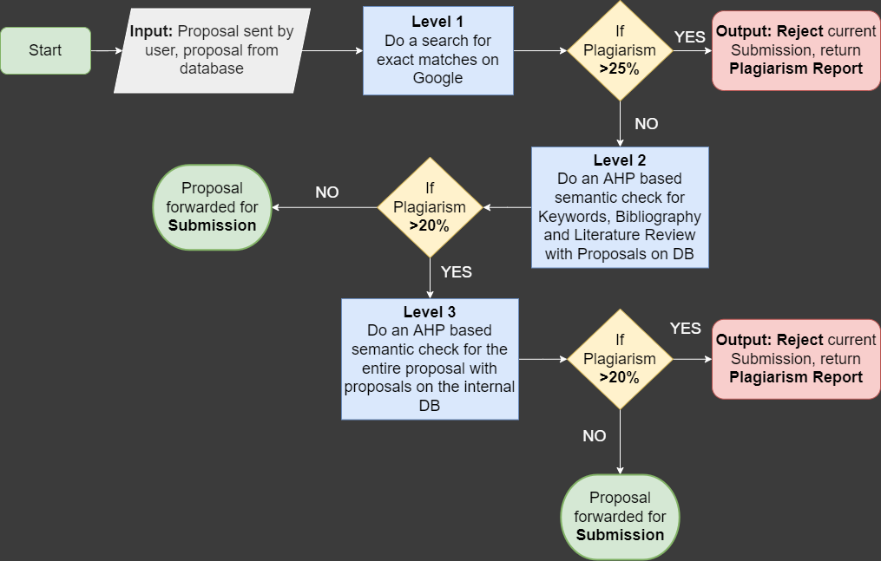
Flow Chart

Slide 20
Performance Measures
Plagiarism detection rate: The percentage of proposals flagged for plagiarism by the custom-built NLP algorithm.
Time to approval: The average time it takes for a proposal to be approved after submission, from the initial submission to the final funding decision.
User satisfaction: The level of satisfaction reported by users of the web app, as measured through surveys or other feedback mechanisms.
Transparency and fairness of the funding allocation process: The level of fairness and transparency of the funding allocation process as reported by funding agencies and researchers.
Feedback rate: The percentage of researchers who receive feedback on why their proposals were not approved.
Resource consumption rate: The average time and resources consumed by researcher when submitting a proposal

Slide 21
Business Model
Revenue Streams:
Subscription fee: Researchers and funding agencies pay a fee to access the central platform for applying for funding and checking for plagiarism.
Commission on funding: A percentage of the funding allocated to the approved proposals is taken as commission.
Premium features: Additional features such as extended storage and advanced plagiarism checks are offered at an additional cost.
Advertising: Targeted ads are shown to researchers and funding agencies.
Data Sale: Data collected from the platform is sold to funding agencies and research organizations.

Slide 22
Business Model ctd…
Value Proposition:
A central platform for researchers to apply for funding and have their proposals checked for plagiarism, reducing the incidence of plagiarism in research proposals.
Facilitating the growth of the research field by connecting innovative minds with funding resources.
Improving the transparency and fairness of the funding allocation process.
Customer Segments:
Agencies, who use the platform to review and approve proposals.
Research organizations, who may purchase data collected from the platform.

Slide 23
Proposed Method
Plagiarism has become a pervasive issue in academic and professional settings, and detecting instances of plagiarism is becoming increasingly challenging due to the rise of digital resources and online information. To combat this problem, this paper proposes a novel approach to plagiarism detection that incorporates a multi-level system for detecting plagiarism. The multi-level system is designed to be both accurate and efficient, comprising three levels of detection: level-0, level-1, and level-2. By utilizing a multi-level approach, the methodology aims to identify instances of plagiarism more comprehensively and accurately, enabling educators and professionals to take swift and appropriate action against offenders.
In level 0, the Google Dorking technique is used to search for potential plagiarized papers available on the internet. This technique is a powerful method that allows for quick identification and verification of potential plagiarized papers. If a paper is found to be plagiarized beyond a set threshold value, it is rejected and does not proceed to level 1.

Slide 24
Proposed Method ctd…
In level 1, plagiarism in the introduction, abstract, and references of the paper is checked. Advanced text comparison algorithms are used to compare the submitted paper with existing papers in a database, and a plagiarism report is generated that highlights any similarities found.
In level 2, a full paper plagiarism check is performed using advanced algorithms to scan the entire paper for plagiarism. A detailed report is generated that highlights any similarities found, ensuring that the paper is original and has not been copied from any other source.
The proposed approach using the Analytic Hierarchy Process (AHP) technique offers a comprehensive and effective solution to the problem of plagiarism detection. The reference for this methodology is taken from JavadiMoghaddam et al (2019) which explains a strategy for plagiarism detection. This methodology offers a practical solution for teachers to quickly identify and reformulate plagiarized papers, allowing them to focus their efforts on the remaining students.

Slide 25
Proposed Method ctd…
This allows for a more detailed and nuanced analysis of potential plagiarism, as it takes into account the fact that different sections of a document may have varying degrees of similarity to other documents. Additionally, by analyzing each section separately, multilevel plagiarism detection can identify cases of plagiarism that may have gone undetected by traditional methods.

Slide 26
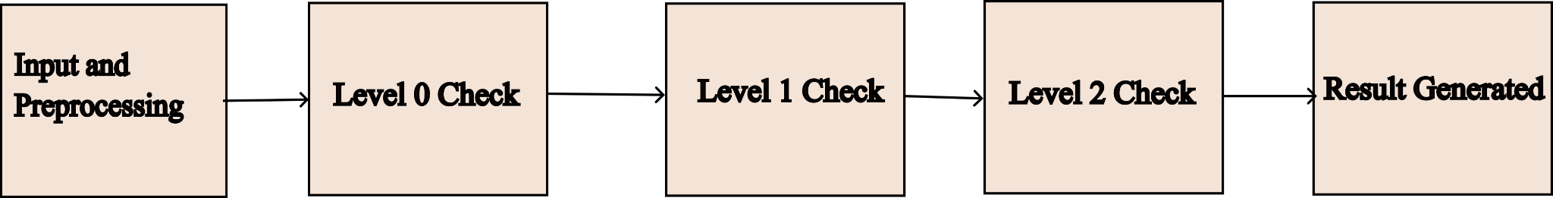
Block Diagram

Slide 27

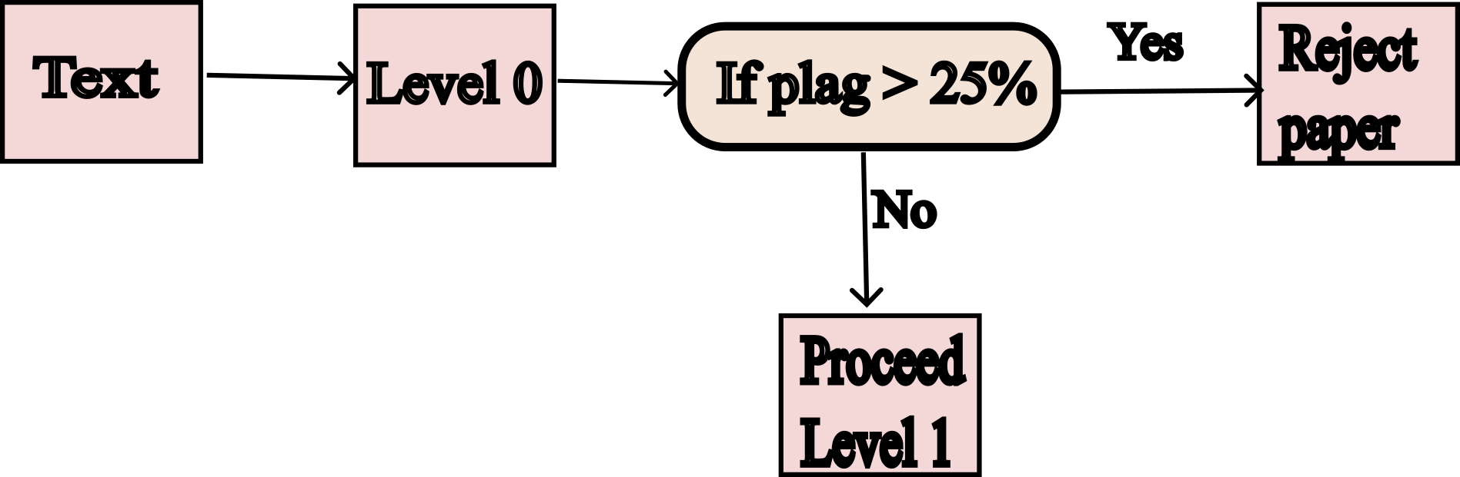
Level - 0 (Google Dorking)

Slide 28
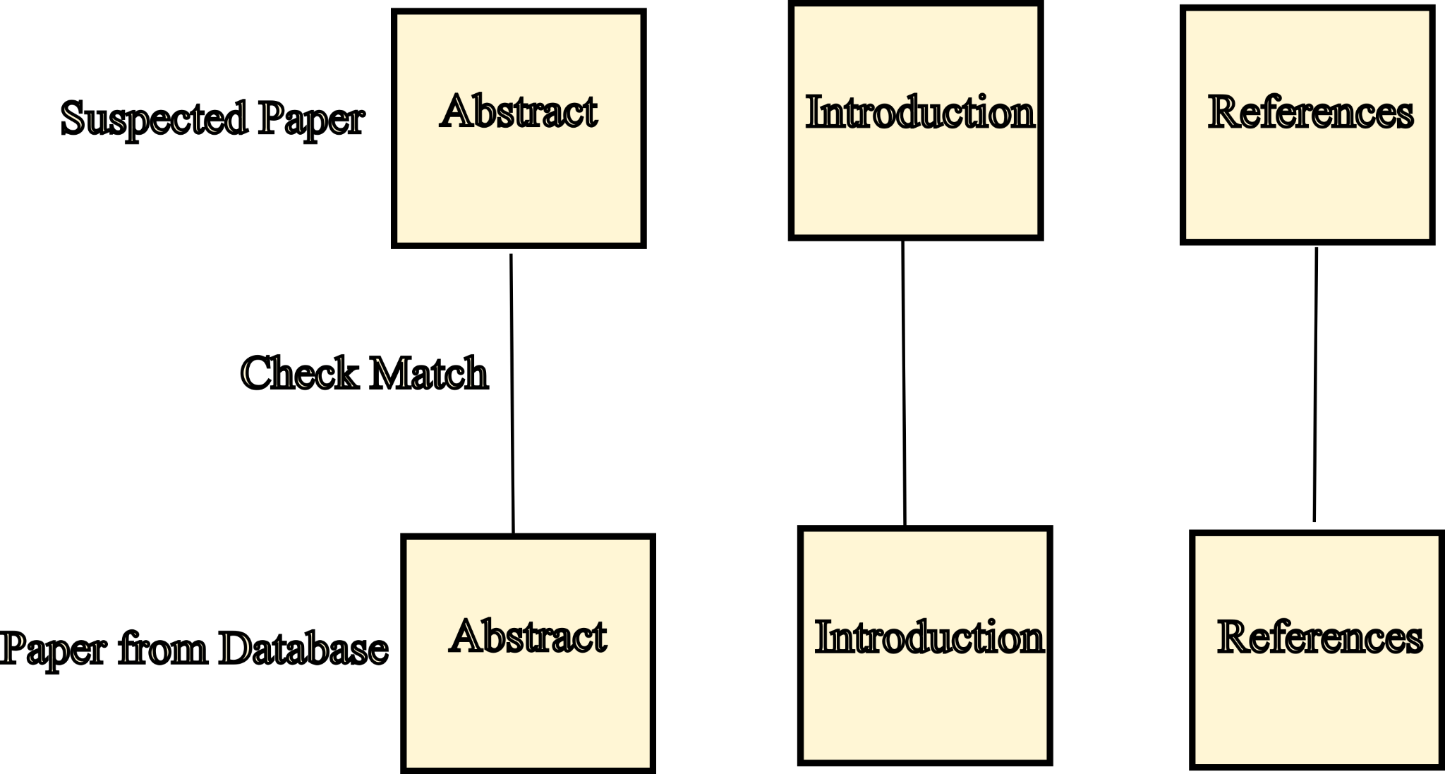
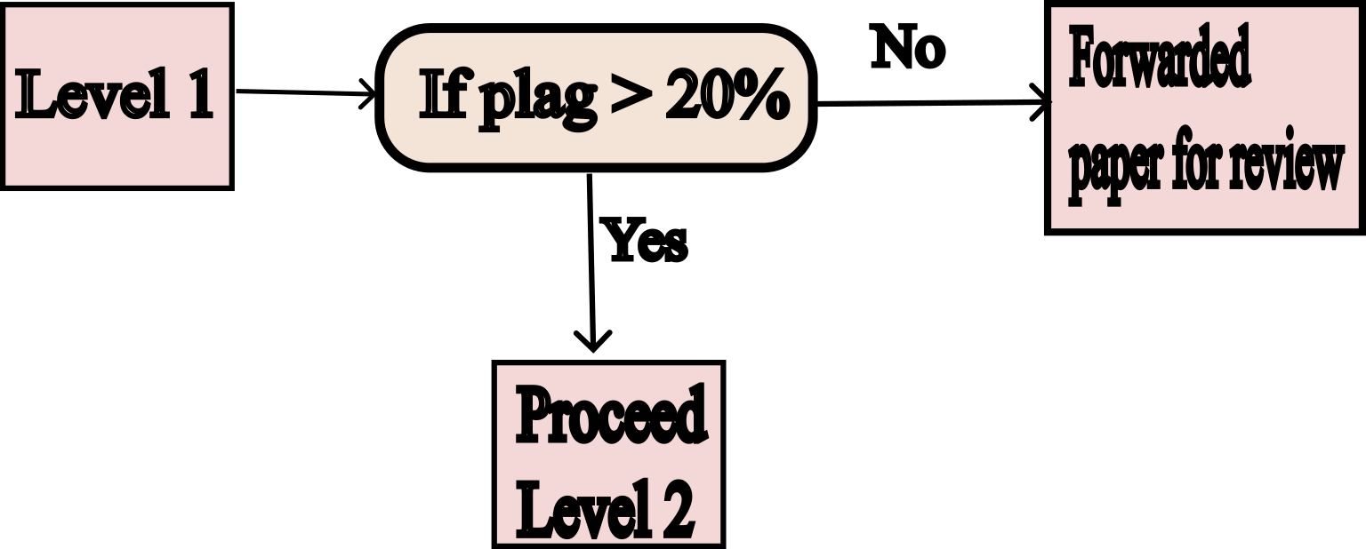
Level - 1
Match Between 2 Papers
Criteria for forwarding paper

Slide 29
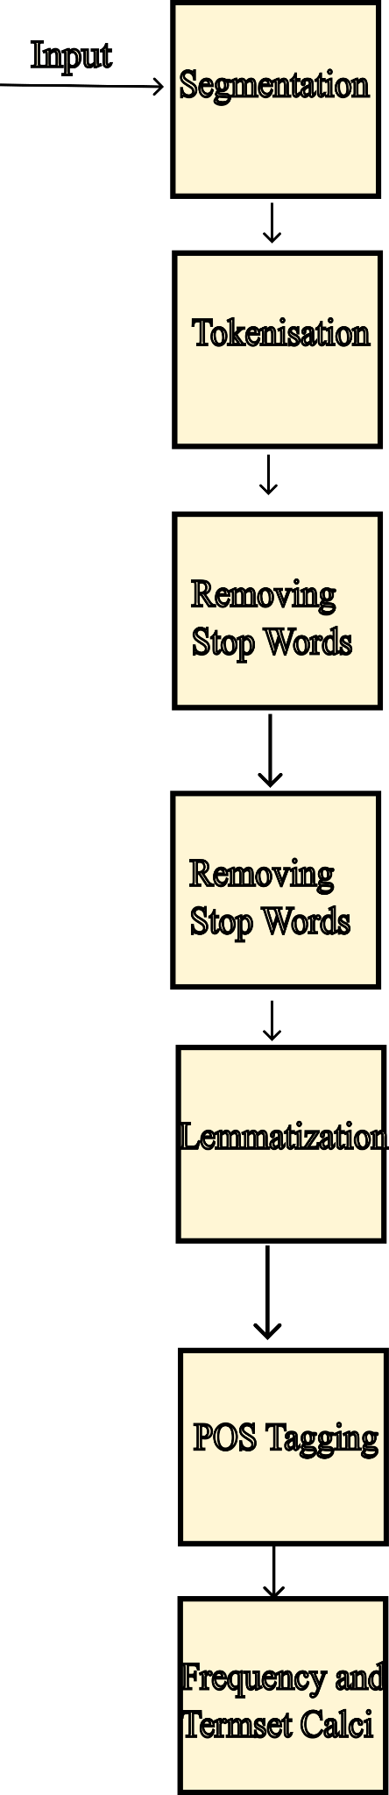
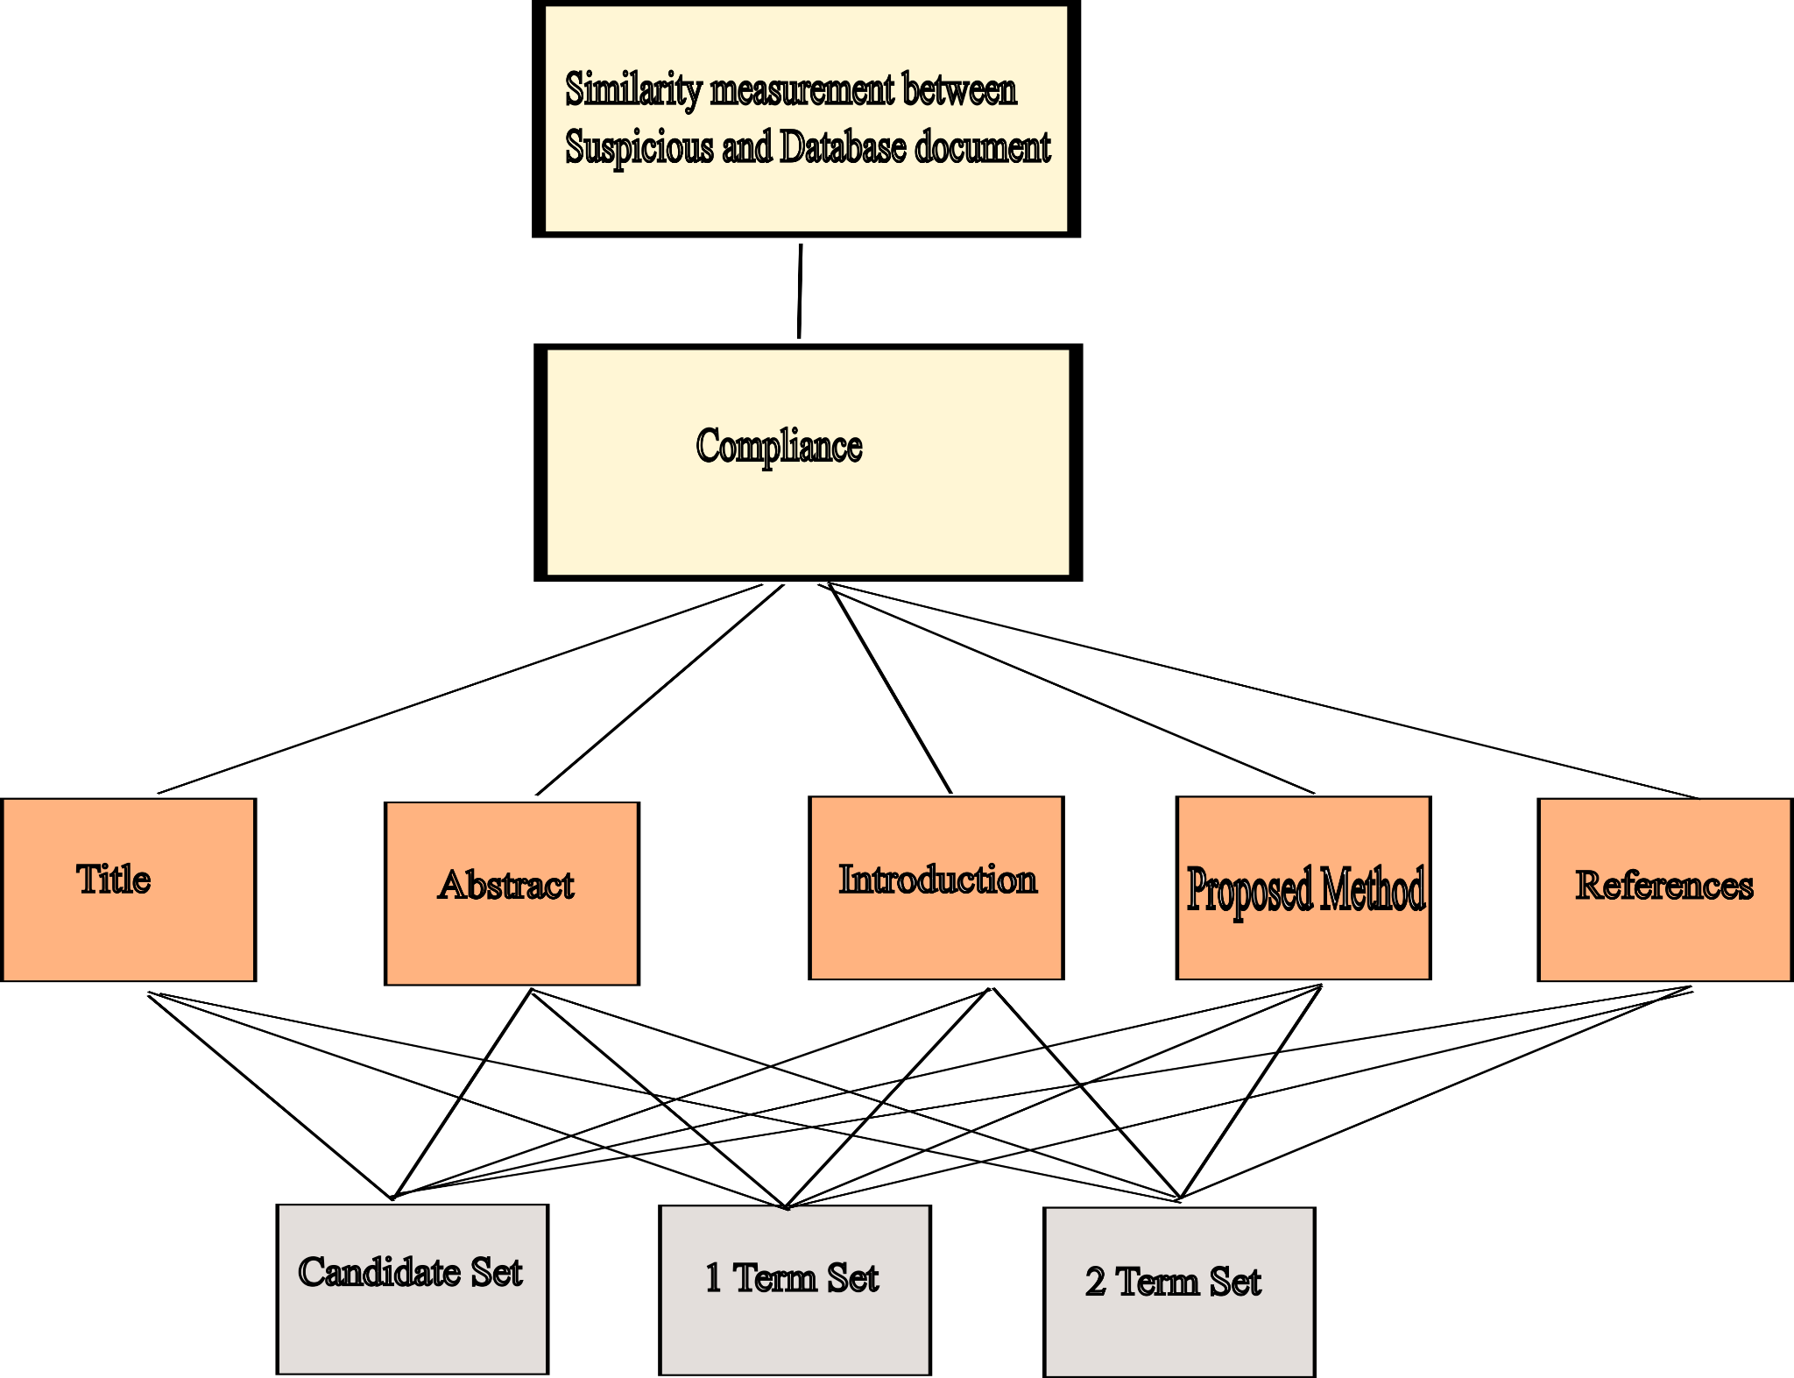
Level - 2
Preprossing
AHP Modelling

Slide 30
Comparison Matrix
Considering a research paper from PubMed - PMC and its ID is PMC5787626 and the paraphrased text is taken by using QuillBot then the result is predicted for the same.
Methodology Used | Similarity Score
SequentialMatcher (Difflib) | 0.12
Our Approach | 0.35

Slide 31
Dataset
Dataset sourced from PubMed, a free online database of biomedical literature maintained by NCBI at NLM.
Consists of articles related to biomedical research, including medicine, nursing, dentistry, veterinary medicine, and public health.
Accessible through PubMed API and contains metadata fields like author, title, abstract, publication date, etc.
PubMed database contains more than 35 million citations and abstracts of biomedical literature.
PubMed dataset is a vast collection of biomedical literature, occupying approximately 122.3 GB of storage space.
BioC format used for easy text processing, available in various forms, including BioC XML or BioC JSON, in Unicode or ASCII, accessed using PubMed ID or PMC ID.

Slide 32
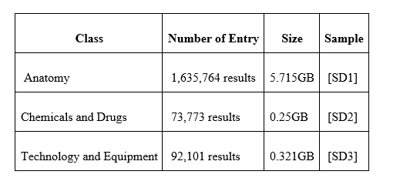
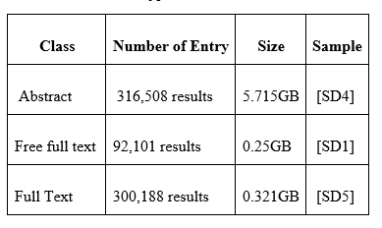
Dataset ctd…
PubMed categorizes biomedical literature into several categories like Anatomy, Chemicals and Drugs, Diseases, etc., and offers various filters like publication dates, article types, languages, etc.
Dataset divided into three categories: Abstract, Free full text, Full-text.
Limited number of full-text papers in the dataset, which makes extracting useful information a challenging task due to their complex and diverse formats.

Slide 33
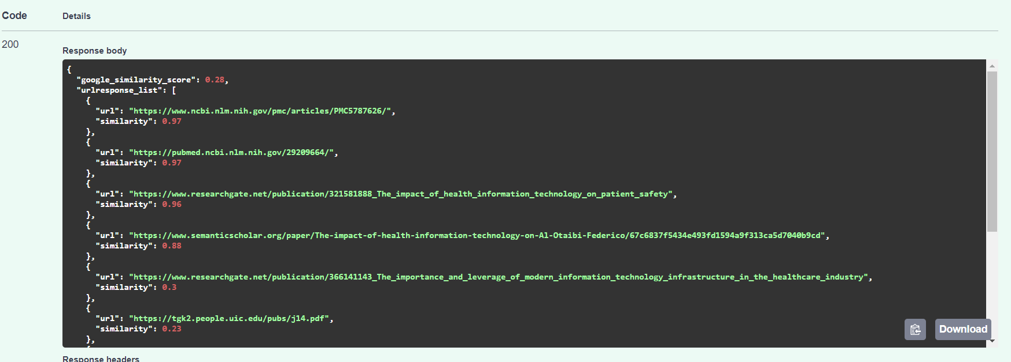
Result
Taking a paper is taken from PMC and its ID is PMC5787626 and it is paraphrased. The result produced by the proposed approach is depicted below.
The output produced by Level-0 is the similarity score corresponding to each matched URL on net

Slide 34
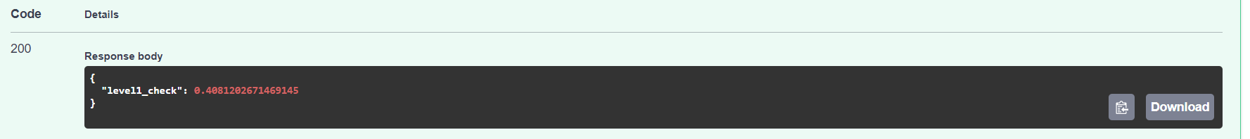
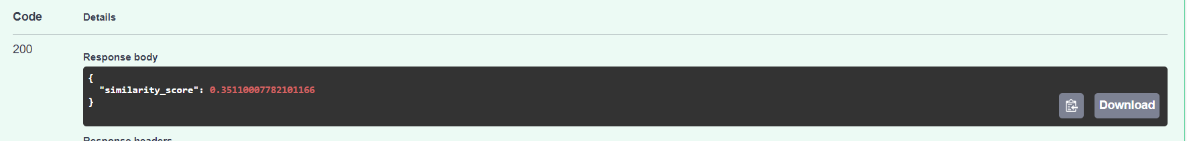
Result ctd…
The output produced by Level-1 is shown below :
The output produced by Level-2 is shown below :

Slide 35
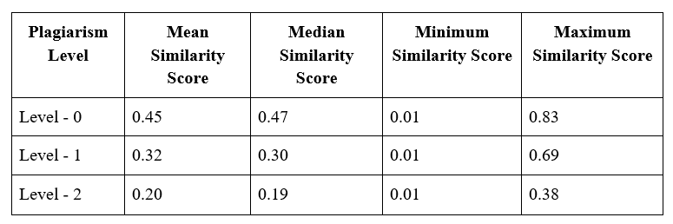
Result ctd…
Statistics of Various Paper Analysed

Slide 36
Conclusion
In conclusion, the widespread access to electronic resources has led to an increase in plagiarism among students. Plagiarism detection tools have been developed to address this issue, but recent studies have shown that they have difficulty identifying more sophisticated forms of plagiarism. In response to this challenge, the proposed approach in this research paper uses the Analytic Hierarchy Process technique to provide a multi-level plagiarism detection system that is both accurate and efficient. The system comprises of three levels of plagiarism detection, including the use of the google dorking technique, advanced text comparison algorithms, and full paper plagiarism check. This approach is essential for ensuring that submitted papers are original and have not been copied from any other source, and it can help teachers identify and reformulate plagiarized papers quickly, allowing them to focus their efforts on the remaining students.

Slide 37
References
[1] Nazir, A., Mir, R. N., & Qureshi, S. (2021). Idea plagiarism detection with recurrent neural networks and vector space model. International Journal of Intelligent Computing and Cybernetics, 14(3), 321–332. https://doi.org/10.1108/ijicc-11-2020-0178
[2] JavadiMoghaddam, S., Roosta, F., & Noroozi, A. (2022). Weighted semantic plagiarism detection approach based on AHP decision model. Accountability in Research, 29(4), 203–223. https://doi.org/10.1080/08989621.2021.1911654
[3] Mansoor, M. N., & Al Tamimi, M. S. H. (n.d.). Plagiarism detection system in scientific publication using lstm networks. Iotpe.com. Retrieved February 2, 2023, from http://www.iotpe.com/IJTPE/IJTPE-2022/IJTPE-Issue53-Vol14-No4-Dec2022/3-IJTPE-Issue53-Vol14-No4-Dec2022-pp17-24.pdf
[4] Alvi, F., Stevenson, M., & Clough, P. (2021). Paraphrase type identification for plagiarism detection using contexts and word embeddings. International Journal of Educational Technology in Higher Education, 18(1), 1–25. https://doi.org/10.1186/s41239-021-00277-8

Slide 38
References ctd…
[5] Arabi, H., & Akbari, M. (2022). Improving plagiarism detection in text document using hybrid weighted similarity. Expert Systems with Applications, 207(118034), 118034. https://doi.org/10.1016/j.eswa.2022.118034
[6] Fokam, M. A., & Ajoodha, R. (2021, November). Influence of Contrastive Learning on Source Code Plagiarism Detection through Recursive Neural Networks. In 2021 3rd International Multidisciplinary Information Technology and Engineering Conference (IMITEC) (pp. 1-6). IEEE.
[7] El-Rashidy, M. A., Mohamed, R. G., El-Fishawy, N. A., & Shouman, M. A. (2022). Reliable plagiarism detection system based on deep learning approaches. Neural Computing and Applications, 34(21), 18837-18858.
[8] Ahuja, L., Gupta, V., & Kumar, R. (2020). A new hybrid technique for detection of plagiarism from text documents. Arabian Journal for Science and Engineering, 45, 9939-9952.
[9] Roostaee, M., Fakhrahmad, S. M., & Sadreddini, M. H. (2020). Cross-language text alignment: A proposed two-level matching scheme for plagiarism detection. Expert Systems with Applications, 160, 113718.

